Slide 1

Three Level inverter
Rachakonda Shri Rama Akshay

Slide 2
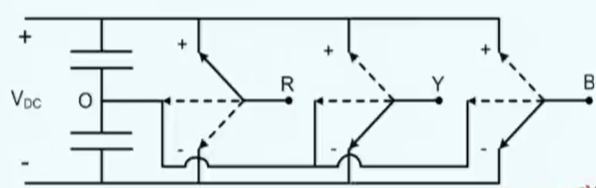
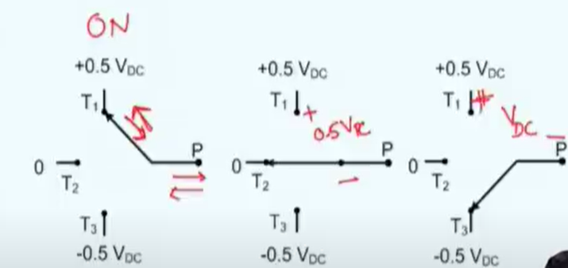
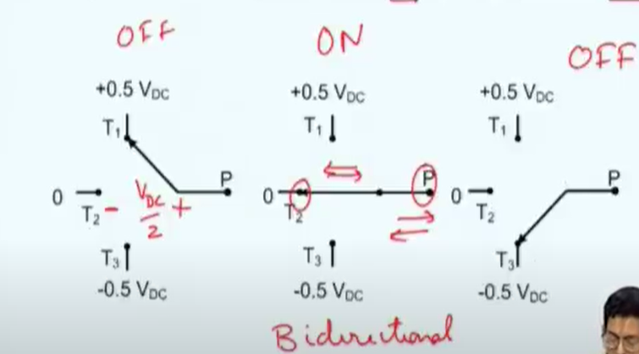
Why three level inverter
Better waveform quality than 2-level inverter
V_{RY} = ± V_{DC}, 0, ± 0.5V_{DC}
R at +, Y at 0, gives 0.5V_{DC}
R at 0, Y at - gives 0.5V_{DC}
Level depends on number pole voltage, VRO= 0.5V_{DC} , 0, - 0.5V_{DC}
Three switches each leg required
Sw1 and sw3
sw2

Slide 3
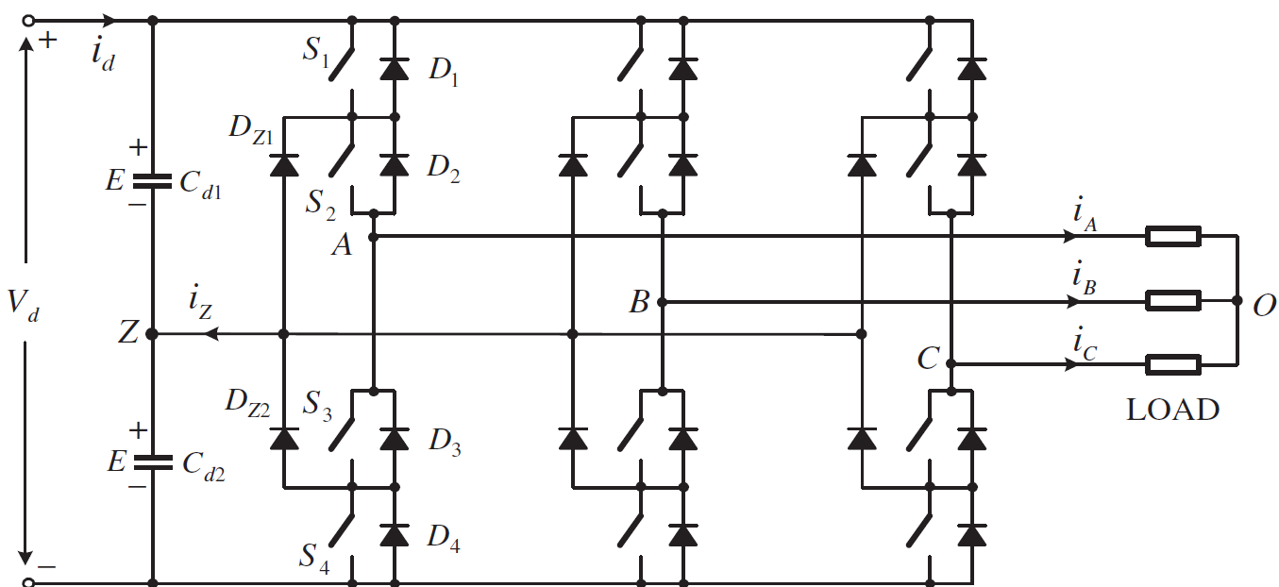
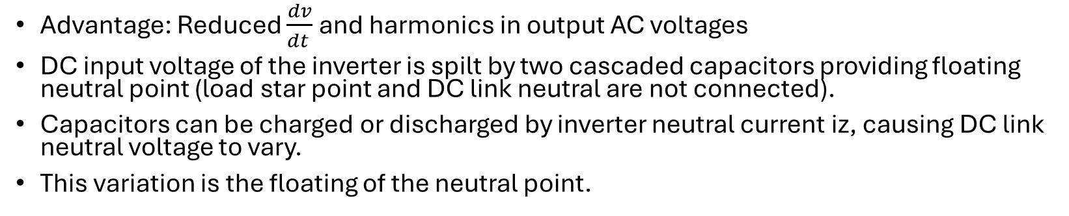
Switching State
Main features 3- Level inverter
Advantage: Reduced $\frac{dv}{dt }$ and harmonics in output AC voltages
DC input voltage of the inverter is spilt by two cascaded capacitors providing floating neutral point (load star point and DC link neutral are not connected).
Capacitors can be charged or discharged by inverter neutral current iz, causing DC link neutral voltage to vary.
This variation is the floating of the neutral point.
Switching State | S1 | S2 | S3 | S4 | Inverter Terminal Volt (AZ)
P | 1 | 1 | 0 | 0 | E
0 | 0 | 1 | 1 | 0 | 0
N | 0 | 0 | 1 | 1 | -E

Slide 4
Switching Combinations
Leg 1 Phase A
 | S1 | S2 | S3 | S4 | Vout
PA | 1 | 1 | 0 | 0 | Vd/2
OA | 0 | 1 | 1 | 0 | 0
NA | 0 | 0 | 1 | 1 | -Vd/2
Leg 2 Phase B
 | S1 | S2 | S3 | S4 | Vout
PB | 1 | 1 | 0 | 0 | Vd/2
OB | 0 | 1 | 1 | 0 | 0
NB | 0 | 0 | 1 | 1 | -Vd/2
Leg 3 Phase C
 | S1 | S2 | S3 | S4 | Vout
PC | 1 | 1 | 0 | 0 | Vd/2
OC | 0 | 1 | 1 | 0 | 0
NC | 0 | 0 | 1 | 1 | -Vd/2
Total Cases
PA can bewith PB, OB, or NB - 3 combination
1 case 3 choice , 3 case 9 combination
PC can be with those 9 combination
three c leg choices with 9 is total 27 combination
3 combination | voltge vector
PA,PB,PC | 0 voltage vector
OA,OB,OC
NA,NB,NC

Slide 5
Phase voltages as per Switching Combinations
 | Possible Switching Combinations |  |  | String Description (Vector symbol on the diagram) | Pole to Mid point Voltage |  |  | Common Mode Voltage | Phase Voltages |  |  | Clark Transform |  | Polar Transform
Combination No. | Ph A | Ph B | Ph C |  | Vao | Vbo | Vco | Vcm= (Vao+Vbo+Vco)/3 | Van | Vbn | Vcn | Vα | Vβ | |V| | θ | θ degree
1 | P | P | P | PPP | 0.5 | 0.5 | 0.5 | 0.500 | 0.000 | 0.000 | 0.000 | 0.00 | 0.00 | 0.00 | NA | NA
2 | O | O | O | OOO | 0 | 0 | 0 | 0.000 | 0.000 | 0.000 | 0.000 | 0.00 | 0.00 | 0.00 | NA | NA
3 | N | N | N | NNN | -0.5 | -0.5 | -0.5 | -0.500 | 0.000 | 0.000 | 0.000 | 0.00 | 0.00 | 0.00 | NA | NA
4 | O | O | P | OOP | 0 | 0 | 0.5 | 0.167 | -0.167 | -0.167 | 0.333 | -0.17 | -0.29 | 0.33 | 4.19 | 240
5 | N | N | O | NNO | -0.5 | -0.5 | 0 | -0.333 | -0.167 | -0.167 | 0.333 | -0.17 | -0.29 | 0.33 | 4.19 | 240
6 | P | O | P | POP | 0.5 | 0 | 0.5 | 0.333 | 0.167 | -0.333 | 0.167 | 0.17 | -0.29 | 0.33 | 5.24 | 300
7 | O | N | O | ONO | 0 | -0.5 | 0 | -0.167 | 0.167 | -0.333 | 0.167 | 0.17 | -0.29 | 0.33 | 5.24 | 300
8 | P | O | O | POO | 0.5 | 0 | 0 | 0.167 | 0.333 | -0.167 | -0.167 | 0.33 | 0.00 | 0.33 | 6.28 | 360
9 | O | N | N | ONN | 0 | -0.5 | -0.5 | -0.333 | 0.333 | -0.167 | -0.167 | 0.33 | 0.00 | 0.33 | 6.28 | 360
10 | P | P | O | PPO | 0.5 | 0.5 | 0 | 0.333 | 0.167 | 0.167 | -0.333 | 0.17 | 0.29 | 0.33 | 1.05 | 60
11 | O | O | N | OON | 0 | 0 | -0.5 | -0.167 | 0.167 | 0.167 | -0.333 | 0.17 | 0.29 | 0.33 | 1.05 | 60
12 | O | P | O | OPO | 0 | 0.5 | 0 | 0.167 | -0.167 | 0.333 | -0.167 | -0.17 | 0.29 | 0.33 | 2.09 | 120
13 | N | O | N | NON | -0.5 | 0 | -0.5 | -0.333 | -0.167 | 0.333 | -0.167 | -0.17 | 0.29 | 0.33 | 2.09 | 120
14 | O | P | P | OPP | 0 | 0.5 | 0.5 | 0.333 | -0.333 | 0.167 | 0.167 | -0.33 | 0.00 | 0.33 | 3.14 | 180
15 | N | O | O | NOO | -0.5 | 0 | 0 | -0.167 | -0.333 | 0.167 | 0.167 | -0.33 | 0.00 | 0.33 | 3.14 | 180
16 | N | O | P | NOP | -0.5 | 0 | 0.5 | 0.000 | -0.500 | 0.000 | 0.500 | -0.50 | -0.29 | 0.58 | 3.67 | 210
17 | O | N | P | ONP | 0 | -0.5 | 0.5 | 0.000 | 0.000 | -0.500 | 0.500 | 0.00 | -0.58 | 0.58 | 4.71 | 270
18 | P | N | O | PNO | 0.5 | -0.5 | 0 | 0.000 | 0.500 | -0.500 | 0.000 | 0.50 | -0.29 | 0.58 | 5.76 | 330
19 | P | O | N | PON | 0.5 | 0 | -0.5 | 0.000 | 0.500 | 0.000 | -0.500 | 0.50 | 0.29 | 0.58 | 0.52 | 30
20 | O | P | N | OPN | 0 | 0.5 | -0.5 | 0.000 | 0.000 | 0.500 | -0.500 | 0.00 | 0.58 | 0.58 | 1.57 | 90
21 | N | P | O | NPO | -0.5 | 0.5 | 0 | 0.000 | -0.500 | 0.500 | 0.000 | -0.50 | 0.29 | 0.58 | 2.62 | 150
22 | N | N | P | NNP | -0.5 | -0.5 | 0.5 | -0.167 | -0.333 | -0.333 | 0.667 | -0.33 | -0.58 | 0.67 | 4.19 | 240
23 | P | N | P | PNP | 0.5 | -0.5 | 0.5 | 0.167 | 0.333 | -0.667 | 0.333 | 0.33 | -0.58 | 0.67 | 5.24 | 300
24 | P | N | N | PNN | 0.5 | -0.5 | -0.5 | -0.167 | 0.667 | -0.333 | -0.333 | 0.67 | 0.00 | 0.67 | 6.28 | 360
25 | P | P | N | PPN | 0.5 | 0.5 | -0.5 | 0.167 | 0.333 | 0.333 | -0.667 | 0.33 | 0.58 | 0.67 | 1.05 | 60
26 | N | P | N | NPN | -0.5 | 0.5 | -0.5 | -0.167 | -0.333 | 0.667 | -0.333 | -0.33 | 0.58 | 0.67 | 2.09 | 120
27 | N | P | P | NPP | -0.5 | 0.5 | 0.5 | 0.167 | -0.667 | 0.333 | 0.333 | -0.67 | 0.00 | 0.67 | 3.14 | 180

Slide 6
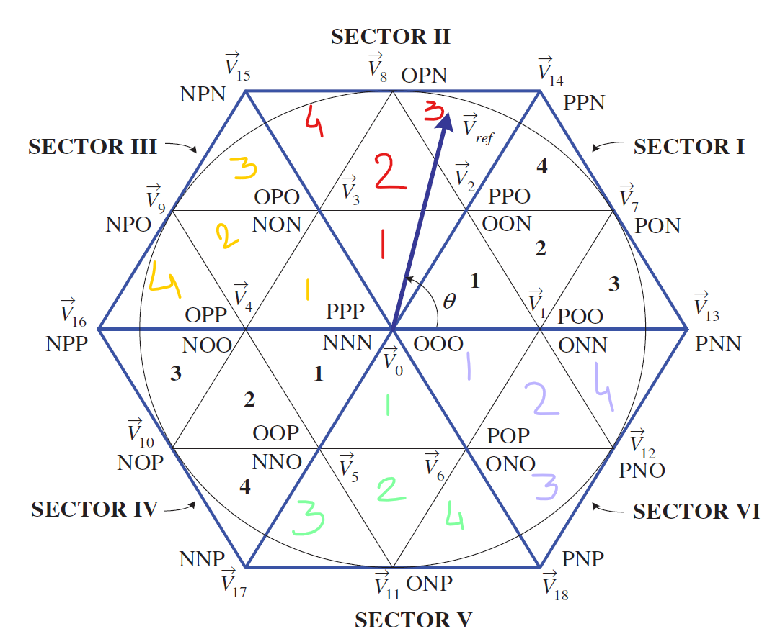
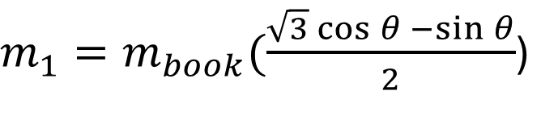
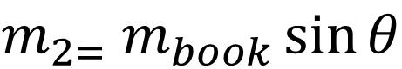
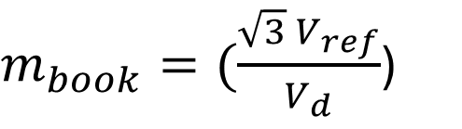
Condition for region selection
Conditions for Region Selection
s. no | Region | Condition
1 | Region 1 | m₁ < 0.5
 |  | m₂ < 0.5
 |  | m₁+m₂ <0.5
2 | Region 2 | m₁ < 0.5
 |  | m₂ < 0.5
 |  | m₁+m₂ > 0.5
3 | Region 3 | m₁ > 0.5
4 | Region 4 | m₂ > 0.5
$m_{book}=(\frac{{\sqrt{3} V}_{ref}}{V_{d}}$)
$m_{1}=m_{book}(\frac{\sqrt{3}\cos{θ −\sin{θ}}}{2}$)
$${m_{2=} m}_{book}\sin{θ}$$

Slide 7
Hard Switching
 |  |  | Ta | Tb | Tc
Sector 1 | Region 1 | S1R1 | V1 | V0 | V2
 | Region 2 | S1R2 | V1 | V7 | V2
 | Region 3 | S1R3 | V1 | V7 | V13
 | Region 4 | S1R4 | V14 | V7 | V2
Sector 2 | Region 1 | S2R1 | V2 | V0 | V3
 | Region 2 | S2R2 | V2 | V8 | V3
 | Region 3 | S2R3 | V2 | V8 | V14
 | Region 4 | S2R4 | V15 | V8 | V3
Sector 3 | Region 1 | S3R1 | V3 | V0 | V4
 | Region 2 | S3R2 | V3 | V9 | V4
 | Region 3 | S3R3 | V3 | V9 | V15
 | Region 4 | S3R4 | V16 | V9 | V4
Sector 4 | Region 1 | S4R1 | V4 | V0 | V5
 | Region 2 | S4R2 | V4 | V10 | V5
 | Region 3 | S4R3 | V4 | V10 | V16
 | Region 4 | S4R4 | V17 | V10 | V5
Sector 5 | Region 1 | S5R1 | V5 | V0 | V6
 | Region 2 | S5R2 | V5 | V11 | V6
 | Region 3 | S5R3 | V5 | V11 | V17
 | Region 4 | S5R4 | V18 | V11 | V6
Sector 6 | Region 1 | S6R1 | V6 | V0 | V1
 | Region 2 | S6R2 | V6 | V12 | V1
 | Region 3 | S6R3 | V6 | V12 | V18
 | Region 4 | S6R4 | V13 | V12 | V1

Slide 8
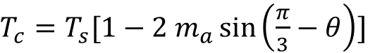
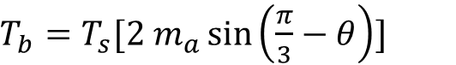
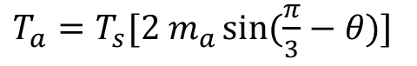
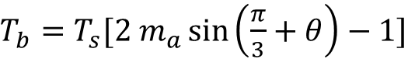
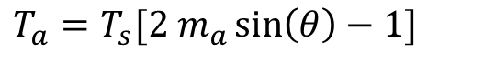
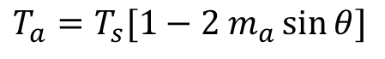
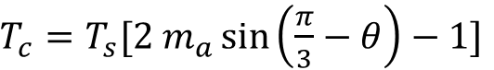
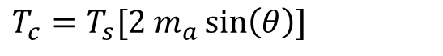
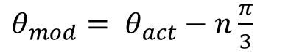
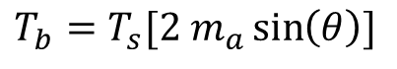
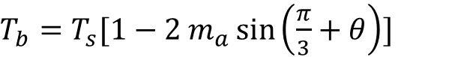
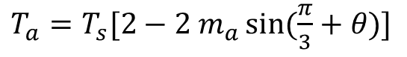
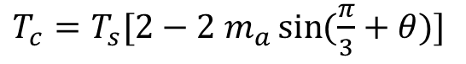
Hard Switching
 |  |  | Ta | Tb | Tc
Sector 1 | Region 1 | S1R1 | V1 | V0 | V2
 | Region 2 | S1R2 | V1 | V7 | V2
 | Region 3 | S1R3 | V1 | V7 | V13
 | Region 4 | S1R4 | V14 | V7 | V2
Sector 2 | Region 1 | S2R1 | V2 | V0 | V3
 | Region 2 | S2R2 | V2 | V8 | V3
 | Region 3 | S2R3 | V2 | V8 | V14
 | Region 4 | S2R4 | V15 | V8 | V3
Sector 3 | Region 1 | S3R1 | V3 | V0 | V4
 | Region 2 | S3R2 | V3 | V9 | V4
 | Region 3 | S3R3 | V3 | V9 | V15
 | Region 4 | S3R4 | V16 | V9 | V4
Sector 4 | Region 1 | S4R1 | V4 | V0 | V5
 | Region 2 | S4R2 | V4 | V10 | V5
 | Region 3 | S4R3 | V4 | V10 | V16
 | Region 4 | S4R4 | V17 | V10 | V5
Sector 5 | Region 1 | S5R1 | V5 | V0 | V6
 | Region 2 | S5R2 | V5 | V11 | V6
 | Region 3 | S5R3 | V5 | V11 | V17
 | Region 4 | S5R4 | V18 | V11 | V6
Sector 6 | Region 1 | S6R1 | V6 | V0 | V1
 | Region 2 | S6R2 | V6 | V12 | V1
 | Region 3 | S6R3 | V6 | V12 | V18
 | Region 4 | S6R4 | V13 | V12 | V1
Region 1
$T_{a}=T_{s}[2 m_{a}\sin{(\frac{π}{3}−θ)}]$
$T_{b}=T_{s}[1−2 m_{a}\sin\left(\frac{π}{3}+θ\right)]$
$T_{c}=T_{s}[2 m_{a}\sin\left(θ\right)]$
Region 2
$T_{a}=T_{s}[1−2 m_{a}\sin{θ}]$
$T_{b}=T_{s}[2 m_{a}\sin\left(\frac{π}{3}+θ\right)−1]$
$T_{c}=T_{s}[1−2 m_{a}\sin\left(\frac{π}{3}−θ\right)]$
Region 4
$θ_{mod}= θ_{act}−n\frac{π}{3}$
$T_{a}=T_{s}[2 m_{a}\sin\left(θ\right)−1]$
N= 0 to 5
$T_{b}=T_{s}[2 m_{a}\sin\left(\frac{π}{3}−θ\right)]$
$T_{a}=T_{s}[2−2 m_{a}\sin{(\frac{π}{3}+θ)}]$
Region 3
$T_{c}=T_{s}[2 m_{a}\sin\left(\frac{π}{3}−θ\right)−1]$
$T_{c}=T_{s}[2−2 m_{a}\sin{(\frac{π}{3}+θ)}]$
$T_{b}=T_{s}[2 m_{a}\sin\left(θ\right)]$

Slide 9
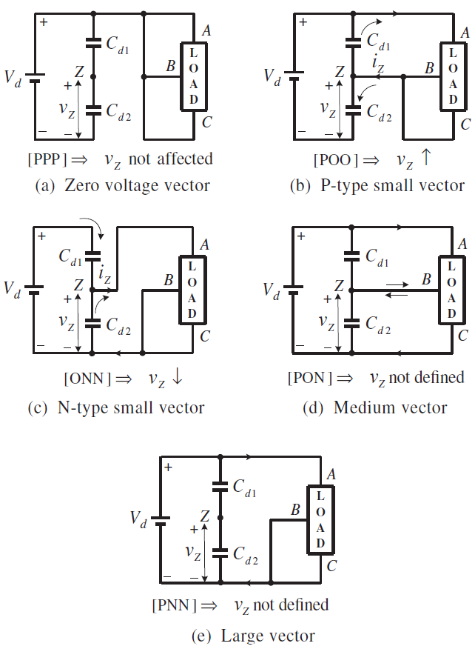
Switching design requirements
 | Requirement of switching sequence design
1 | Transition from one switching state to another switching state requires operation of two switches within same leg
 | One switch turns On, another Turns Off
2 | Transition of Vref from one region or sector to another must take minimum switching
 | Effect of Switching states on Vz Voltage deviaiton
1 | O states [PPP,OOO,NNN] | Z is disconnected no change
2 | POO | iz current flows into Z point, voltge increases
3 | ONN | iz current flows out of Z point, voltge decreases
4 | PON | A phsae +ve, B phase 0 volt, C phase - ve | the current to Z point depends on the inverter - network condition
5 | PNN | Phases are connected between +ve and -ve and Z point is diconnected so no impact on neutral volt

Slide 10
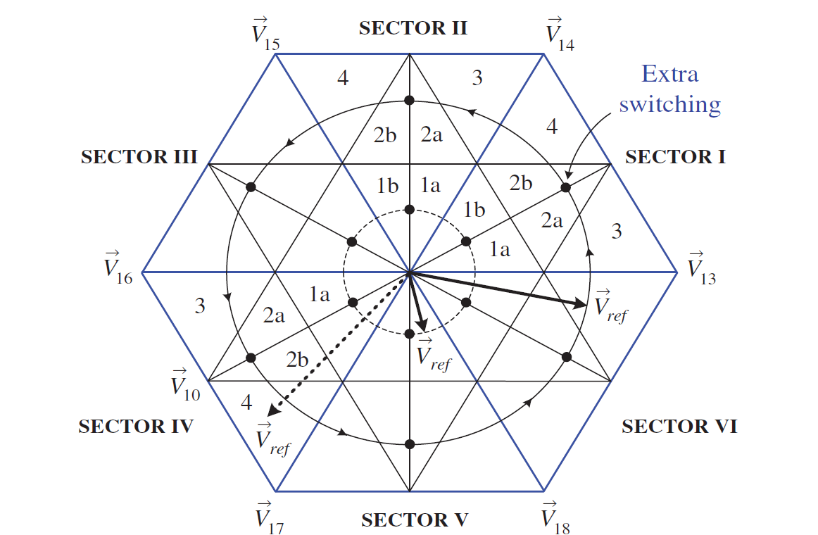
Subregion Selection for Minimum Voltage deviation
Sector 1 |  | Ta/4 | Tb/2 | Tc/2 | Ta/2 | Tc/2 | Tb/2 | Ta/4
 | S1R1a | V1P(POO) | V0(OOO) | V2N(OON) | V1b; | V2N(OON) | V0(OOO) | V1P(POO)
 |  | Tc/4 | Tb/2 | Ta/2 | Tc/2 | Ta/2 | Tb/2 | Tc/4
 | S1R1b | V2N(OON) | V0(OOO) | V1P(POO) | V2P(PPO) | V1P(POO) | V0(OOO) | V2N(OON)
 |  | Ta/4 | Tb/2 | Tc/2 | Ta/2 | Tc/2 | Tb/2 | Ta/4
 | S1R2a | V1P(POO) | V7(PON) | V2N(OON) | V1N(ONN) | V2N(OON) | V7(PON) | V1P(POO)
 |  | Tc/4 | Tb/2 | Ta/2 | Tc/2 | Ta/2 | Tb/2 | Tc/4
 | S1R2b | V2N(OON) | V7(PON) | V1P(POO) | V2P(PPO) | V1P(POO) | V7(PON) | V2N(OON)
 |  | Ta/4 | Tb/2 | Tc/2 | Ta/2 | Tc/2 | Tb/2 | Ta/4
 | S1R3 | V1P(POO) | V7(PON) | V13(PNN) | V1N(ONN) | V13(PNN) | V7(PON) | V1P(POO)
 |  | Tc/4 | Tb/2 | Ta/2 | Tc/2 | Ta/2 | Tb/2 | Tc/4
 | S1R4 | V2N(OON) | V7(PON) | V14(PPN) | V2P(PPO) | V14(PPN) | V7(PON) | V2N(OON)
Sector 2 |  | Ta/4 | Tb/2 | Tc/2 | Ta/2 | Tc/2 | Tb/2 | Ta/4
 | S2R1a | V2N(OON) | V0(OOO) | V3P(OPO) | V2P(PPO) | V3P(OPO) | V0(OOO) | V2N(OON)
 |  | Tc/4 | Tb/2 | Ta/2 | Tc/2 | Ta/2 | Tb/2 | Tc/4
 | S2R1b | V3P(OPO) | V0(OOO) | V2N(OON) | V3N(NON) | V2N(OON) | V0(OOO) | V3P(OPO)
 |  | Ta/4 | Tb/2 | Tc/2 | Ta/2 | Tc/2 | Tb/2 | Ta/4
 | S2R2a | V2N(OON) | V8(OPN) | V3P(OPO) | V2P(PPO) | V3P(OPO) | V8(OPN) | V2N(OON)
 |  | Tc/4 | Tb/2 | Ta/2 | Tc/2 | Ta/2 | Tb/2 | Tc/4
 | S2R2b | V3P(OPO) | V8(OPN) | V2N(OON) | V3N(NON) | V2N(OON) | V8(OPN) | V3P(OPO)
 |  | Ta/4 | Tb/2 | Tc/2 | Ta/2 | Tc/2 | Tb/2 | Ta/4
 | S2R3 | V2N(OON) | V8(OPN) | V14(PPN) | V2P(PPO) | V14(PPN) | V8(OPN) | V2N(OON)
 |  | Tc/4 | Tb/2 | Ta/2 | Tc/2 | Ta/2 | Tb/2 | Tc/4
 | S2R4 | V3P(OPO) | V8(OPN) | V15(NPN) | V3N(NON) | V15(NPN) | V8(OPN) | V3P(OPO)

Slide 11
Subregion Selection for Minimum Voltage deviation
Sector 3 |  | Ta/4 | Tb/2 | Tc/2 | Ta/2 | Tc/2 | Tb/2 | Ta/4
 | S3R1a | V3P(OPO) | V0(OOO) | V4N(NOO) | V3N(NON) | V4N(NOO) | V0(OOO) | V3P(OPO)
 |  | Tc/4 | Tb/2 | Ta/2 | Tc/2 | Ta/2 | Tb/2 | Tc/4
 | S3R1b | V4N(NOO) | V0(OOO) | V3P(OPO) | V4P(OPP) | V3P(OPO) | V0(OOO) | V4N(NOO)
 |  | Ta/4 | Tb/2 | Tc/2 | Ta/2 | Tc/2 | Tb/2 | Ta/4
 | S3R2a | V3P(OPO) | V9(NPO) | V4N(NOO) | V3N(NON) | V4N(NOO) | V9(NPO) | V3P(OPO)
 |  | Tc/4 | Tb/2 | Ta/2 | Tc/2 | Ta/2 | Tb/2 | Tc/4
 | S3R2b | V4N(NOO) | V9(NPO) | V3P(OPO) | V4P(OPP) | V3P(OPO) | V9(NPO) | V4N(NOO)
 |  | Ta/4 | Tb/2 | Tc/2 | Ta/2 | Tc/2 | Tb/2 | Ta/4
 | S3R3 | V3P(OPO) | V9(NPO) | V15(NPN) | V3N(NON) | V15(NPN) | V9(NPO) | V3P(OPO)
 |  | Tc/4 | Tb/2 | Ta/2 | Tc/2 | Ta/2 | Tb/2 | Tc/4
 | S3R4 | V4N(NOO) | V9(NPO) | V16(NPP) | V4P(OPP) | V16(NPP) | V9(NPO) | V4N(NOO)
Sector 5 |  | Ta/4 | Tb/2 | Tc/2 | Ta/2 | Tc/2 | Tb/2 | Ta/4
 | S5R1a | V5P(OOP) | V0(OOO) | V6N(ONO) | V5N(NNO) | V6N(ONO) | V0(OOO) | V5P(OOP)
 |  | Tc/4 | Tb/2 | Ta/2 | Tc/2 | Ta/2 | Tb/2 | Tc/4
 | S5R1b | V6N(ONO) | V0(OOO) | V5P(OOP) | V6P(POP) | V5P(OOP) | V0(OOO) | V6N(ONO)
 |  | Ta/4 | Tb/2 | Tc/2 | Ta/2 | Tc/2 | Tb/2 | Ta/4
 | S5R2a | V5P(OOP) | V11(ONP) | V6N(ONO) | V5N(NNO) | V6N(ONO) | V11(ONP) | V5P(OOP)
 |  | Tc/4 | Tb/2 | Ta/2 | Tc/2 | Ta/2 | Tb/2 | Tc/4
 | S5R2b | V6N(ONO) | V11(ONP) | V5P(OOP) | V6P(POP) | V5P(OOP) | V11(ONP) | V6N(ONO)
 |  | Ta/4 | Tb/2 | Tc/2 | Ta/2 | Tc/2 | Tb/2 | Ta/4
 | S5R3 | V5P(OOP) | V11(ONP) | V17(NNP) | V5N(NNO) | V17(NNP) | V11(ONP) | V5P(OOP)
 |  | Tc/4 | Tb/2 | Ta/2 | Tc/2 | Ta/2 | Tb/2 | Tc/4
 | S5R4 | V6N(ONO) | V11(ONP) | V18(PNP) | V6P(POP) | V18(PNP) | V11(ONP) | V6N(ONO)
Sector 4 |  | Ta/4 | Tb/2 | Tc/2 | Ta/2 | Tc/2 | Tb/2 | Ta/4
 | S4R1a | V4N(NOO) | V0(OOO) | V5P(OOP) | V4P(OPP) | V5P(OOP) | V0(OOO) | V4N(NOO)
 |  | Tc/4 | Tb/2 | Ta/2 | Tc/2 | Ta/2 | Tb/2 | Tc/4
 | S4R1b | V5P(OOP) | V0(OOO) | V4N(NOO) | V5N(NNO) | V4N(NOO) | V0(OOO) | V5P(OOP)
 |  | Ta/4 | Tb/2 | Tc/2 | Ta/2 | Tc/2 | Tb/2 | Ta/4
 | S4R2a | V4N(NOO) | V10(NOP) | V5P(OOP) | V4P(OPP) | V5P(OOP) | V10(NOP) | V4N(NOO)
 |  | Tc/4 | Tb/2 | Ta/2 | Tc/2 | Ta/2 | Tb/2 | Tc/4
 | S4R2b | V5P(OOP) | V10(NOP) | V4N(NOO) | V5N(NNO) | V4N(NOO) | V10(NOP) | V5P(OOP)
 |  | Ta/4 | Tb/2 | Tc/2 | Ta/2 | Tc/2 | Tb/2 | Ta/4
 | S4R3 | V4N(NOO) | V10(NOP) | V16(NPP) | V4P(OPP) | V16(NPP) | V10(NOP) | V4N(NOO)
 |  | Tc/4 | Tb/2 | Ta/2 | Tc/2 | Ta/2 | Tb/2 | Tc/4
 | S4R4 | V5P(OOP) | V10(NOP) | V17(NNP) | V5N(NNO) | V17(NNP) | V10(NOP) | V5P(OOP)
Sector 6 |  | Ta/4 | Tb/2 | Tc/2 | Ta/2 | Tc/2 | Tb/2 | Ta/4
 | S6R1a | V6N(ONO) | V0(OOO) | V1P(POO) | V6P(POP) | V1P(POO) | V0(OOO) | V6N(ONO)
 |  | Tc/4 | Tb/2 | Ta/2 | Tc/2 | Ta/2 | Tb/2 | Tc/4
 | S6R1b | V1P(POO) | V0(OOO) | V6N(ONO) | V1N(ONN) | V6N(ONO) | V0(OOO) | V1P(POO)
 |  | Ta/4 | Tb/2 | Tc/2 | Ta/2 | Tc/2 | Tb/2 | Ta/4
 | S6R2a | V6N(ONO) | V12(PNO) | V1P(POO) | V6P(POP) | V1P(POO) | V12(PNO) | V6N(ONO)
 |  | Tc/4 | Tb/2 | Ta/2 | Tc/2 | Ta/2 | Tb/2 | Tc/4
 | S6R2b | V1P(POO) | V12(PNO) | V6N(ONO) | V1N(ONN) | V6N(ONO) | V12(PNO) | V1P(POO)
 |  | Ta/4 | Tb/2 | Tc/2 | Ta/2 | Tc/2 | Tb/2 | Ta/4
 | S6R3 | V6N(ONO) | V12(PNO) | V18(PNP) | V6P(POP) | V18(PNP) | V12(PNO) | V6N(ONO)
 |  | Tc/4 | Tb/2 | Ta/2 | Tc/2 | Ta/2 | Tb/2 | Tc/4
 | S6R4 | V1P(POO) | V12(PNO) | V13(PNN) | V1N(ONN) | V13(PNN) | V12(PNO) | V1P(POO)

Slide 12
Parameters
Vd | 400 | V
Fsw | 900 | Hz
Fref | 50 | Hz
Pphase | 1 | kW
Qphase | 0.484 | kVAr

Slide 13
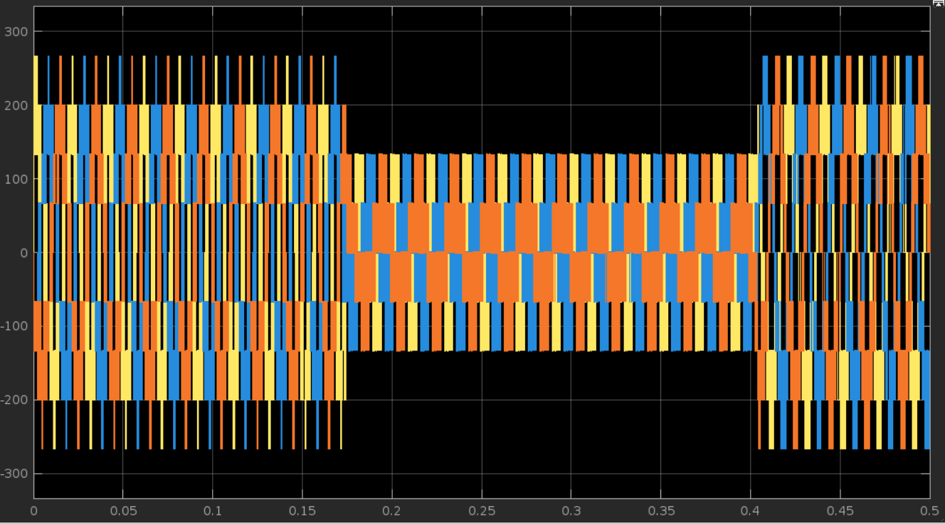
Results

Slide 14
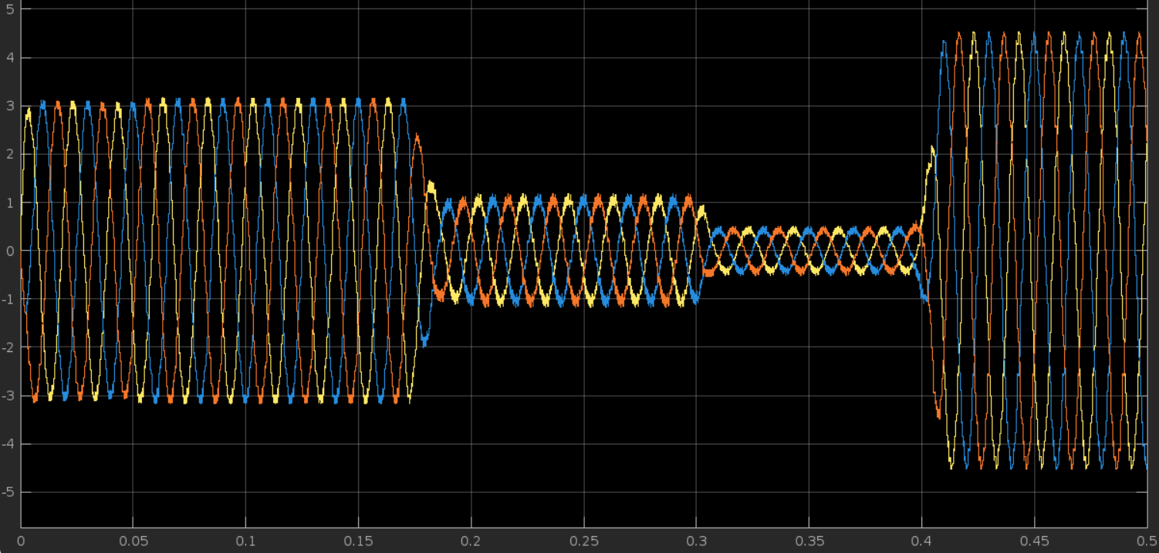
Results

